Slide 1




Programa de Educación el la fe
para padre y adultos

Slide 2






Temas del Curso 2025-2026
SEPTIEMBRE
OCTUBRE
TALLER DE VIRTUS
MARTES OCTUBRE 1
SESIÓN EN ESPAÑOL
23 / 27
14 / 18
Quien soy yo
Somos Imagen de Dios
NOVIEMBRE
TALLER DE VIRTUS
JUEVES NOVIEMBRE 13
INGLES & ESPAÑOL
Dios
18 / 22
Horarios: Martes: 6:45 pm a 8:45 pm o Sábados 9 am a 11 am en el Salón Parroquial
All Human Life is Worth Respect
Notes:
You can use this slide as your opening or closing slide. Should you choose to use it as a closing, make sure you review the main points of your presentation. One creative way to do that is by adding animations to the various graphics on a slide. This slide has 4 different graphics, and, when you view the slideshow, you will see that you can click to reveal the next graphic. Similarly, as you review the main topics in your presentation, you may want each point to show up when you are addressing that topic.
Add animation to images and graphics:
Select your image or graphic.
Click on the Animations tab.
Choose from the options. The animation for this slide is “Split”. The drop-down menu in the Animation section gives even more animations you can use.
If you have multiple graphics or images, you will see a number appear next to it that notes the order of the animations.
Note: You will want to choose the animations carefully. You do not want to make your audience dizzy from your presentation.

Slide 3

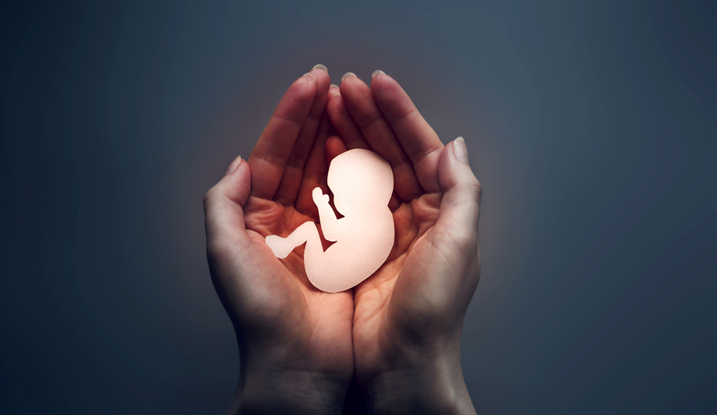
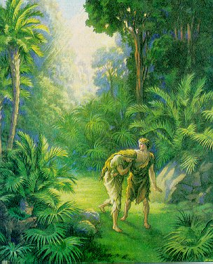


ENERO
FEBRERO
10 / 14
DICIEMBRE
ENERO 13 /17
LOS SACRAMENTOS
9 / 13
27 / 31
La caída del hombre
La Biblia palabra de Dios
La vida humana es digna de respeto
Temas del Curso 2025-2026
Horarios: Martes: 6:45 pm a 8:45 pm o Sábados 9 am a 11 am en el Salón Parroquial
Notes:
You can use this slide as your opening or closing slide. Should you choose to use it as a closing, make sure you review the main points of your presentation. One creative way to do that is by adding animations to the various graphics on a slide. This slide has 4 different graphics, and, when you view the slideshow, you will see that you can click to reveal the next graphic. Similarly, as you review the main topics in your presentation, you may want each point to show up when you are addressing that topic.
Add animation to images and graphics:
Select your image or graphic.
Click on the Animations tab.
Choose from the options. The animation for this slide is “Split”. The drop-down menu in the Animation section gives even more animations you can use.
If you have multiple graphics or images, you will see a number appear next to it that notes the order of the animations.
Note: You will want to choose the animations carefully. You do not want to make your audience dizzy from your presentation.

Slide 4

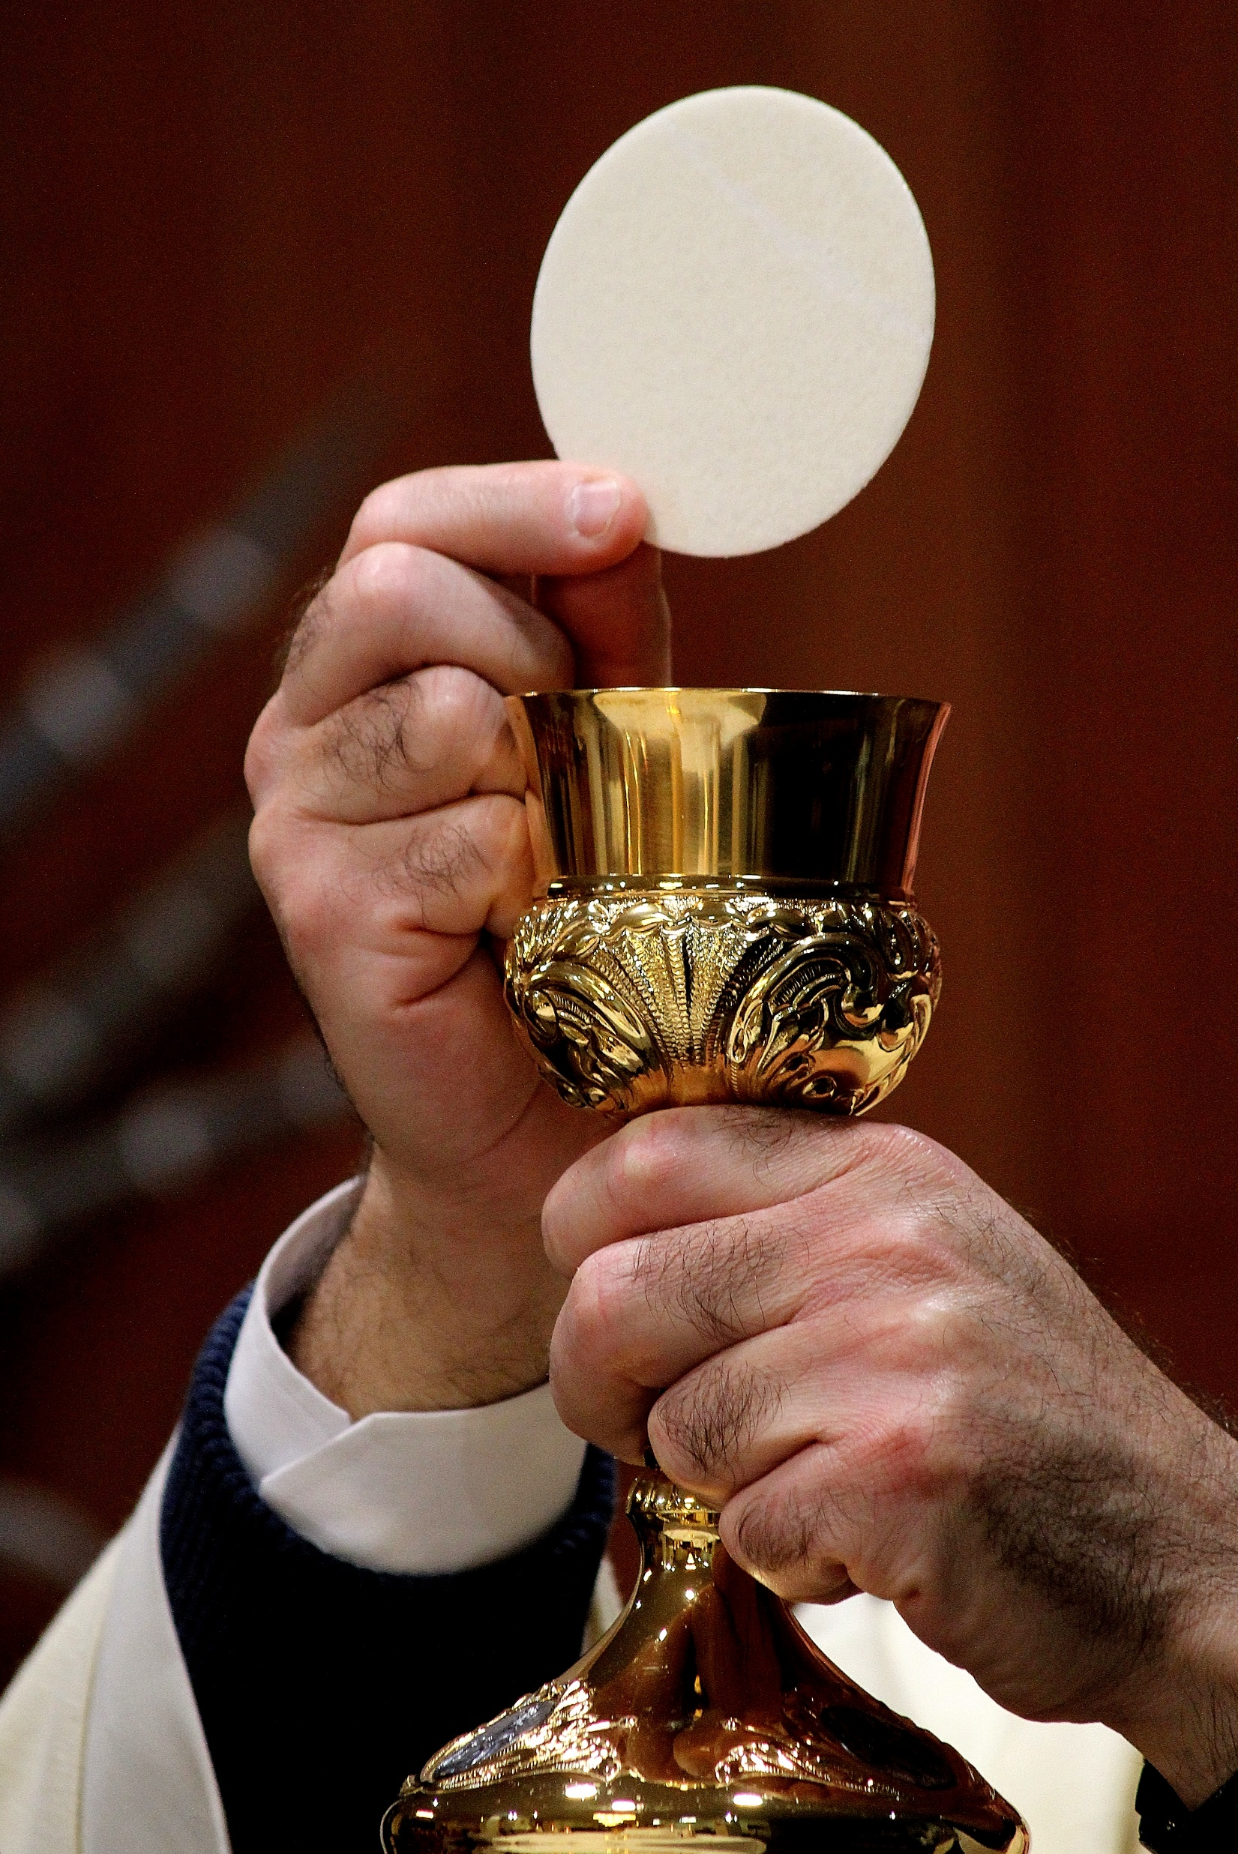


MARZO
ABRIL
7 / 11
ABRIL /MAYO
FEBRERO
24 / 28
28 / 2
24 / 28
La Santa Misa
La familia centro de vocaciones
La moral Cristiana
Los cinco mandamientos de la Iglesia
Temas del Curso 2025-2026
Horarios: Martes: 6:45 pm a 8:45 pm o Sábados 9 am a 11 am en el Salón Parroquial
Notes:
You can use this slide as your opening or closing slide. Should you choose to use it as a closing, make sure you review the main points of your presentation. One creative way to do that is by adding animations to the various graphics on a slide. This slide has 4 different graphics, and, when you view the slideshow, you will see that you can click to reveal the next graphic. Similarly, as you review the main topics in your presentation, you may want each point to show up when you are addressing that topic.
Add animation to images and graphics:
Select your image or graphic.
Click on the Animations tab.
Choose from the options. The animation for this slide is “Split”. The drop-down menu in the Animation section gives even more animations you can use.
If you have multiple graphics or images, you will see a number appear next to it that notes the order of the animations.
Note: You will want to choose the animations carefully. You do not want to make your audience dizzy from your presentation.

Slide 5

MAYO 26 / 30
Retiros generales 2026
FEBRERO 21 & 22
8:00 am -6:00 pm
Donación: $30.00
por persona
MARCH 21st & 22nd
English Retreat
MAY 23rd & 24th
Las Drogas en las Familias
Temas del Curso 2025-2026
Horarios: Martes: 6:45 pm a 8:45 pm o Sábados 9 am a 11 am en el Salón Parroquial
Notes:
You can use this slide as your opening or closing slide. Should you choose to use it as a closing, make sure you review the main points of your presentation. One creative way to do that is by adding animations to the various graphics on a slide. This slide has 4 different graphics, and, when you view the slideshow, you will see that you can click to reveal the next graphic. Similarly, as you review the main topics in your presentation, you may want each point to show up when you are addressing that topic.
Add animation to images and graphics:
Select your image or graphic.
Click on the Animations tab.
Choose from the options. The animation for this slide is “Split”. The drop-down menu in the Animation section gives even more animations you can use.
If you have multiple graphics or images, you will see a number appear next to it that notes the order of the animations.
Note: You will want to choose the animations carefully. You do not want to make your audience dizzy from your presentation.

